Slide 1
AI-Assisted Scripture Display
TCNJ AI/ML Group

Slide 2
Architecture
parser.py
Convert text to Bibleshow bible verse format
Identify the scripture in the text and display all the bible verses
Convert text to bible verse in a specific format
bibleshow.py
Search for scripture in BibleShow
Launch BibleSHow if not already active and display the scripture
Search for the spoken scripture
script.py
Convert speech to text
Dependency:
pip install SpeechRecognition[audio]
Audio input
Mic/speaker
ffmpeg
speech
text
text
Needs to be installed
locally on the PC
Uses Google Speech API
Replace with a speech-to-text ML model
Running locally on the PC
TODO
TODO
Robotic Process Automation can
be used to control BibleShow
Or, we can create an electron App
In Javaacript that implements all 3 scripts
(i.e script.py, parser.py & bibleshow.py)
CLI:
ffmpeg –f dshow –i audio=“<Audio Source name>” –ar 16000 –ac 1 –f wav pipe:1 | python script.py | python parser.py | python bibleshow.py

Slide 3
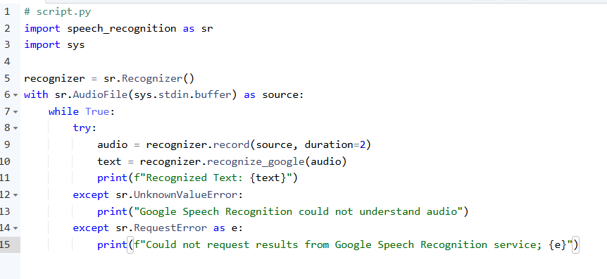
script.py
Test
ffmpeg –f dshow –i audio=“<Audio Source name>” –ar 16000 –ac 1 –f wav pipe:1 | python script.py

